Slide 1
BOOTSTRAP AND LOTTIES
https://github.com/tnt-summer-academy/Curriculum-2022/blob/main/Week%203/%5BENG3.4%5DView%20component%20layout.md
Created for Microsoft / TNTs

Slide 2
Learning objectives
TNTs will be able to install a UI Component Library and use a component in a React project
TNTs will identify requirements, challenges and resources for integrating library components
TNT will specifically learn about React-Bootstrap and Lottie

Slide 3
PART 0 CODE

Slide 4
Code for today
Code
https://github.com/tnt-summer-academy/Samples/tree/main/Week_3/react-bootstrap-javascript
npm install --force
npm install react-router-dom@5.3.3 --force
npm install react-bootstrap bootstrap@4.6.0 --force
(because we will be using Bootstrap React)
npm install sass
(CSS compiler for Bootstrap)
npm install holderjs --force
(because we use some image placeholders)
npm install @fluentui/react --force
(because we will be using fluentui)
npm install react-async --save --force
(because we will fetch data online when using an API)
npm install --save react-lottie
(because we will use Lotties)

Slide 5
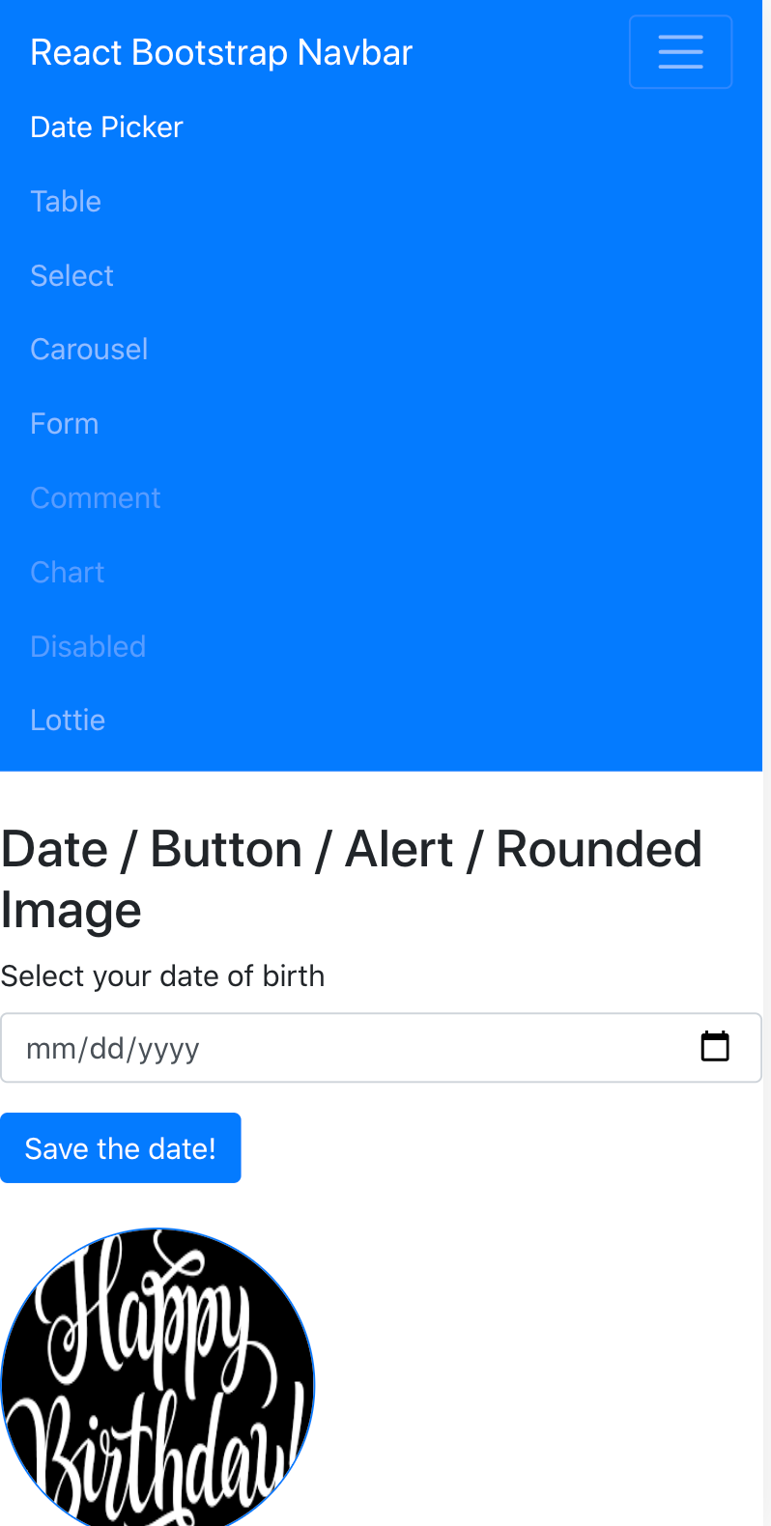
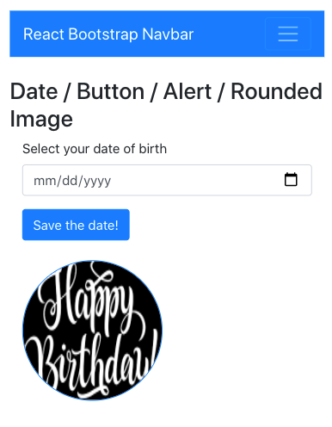
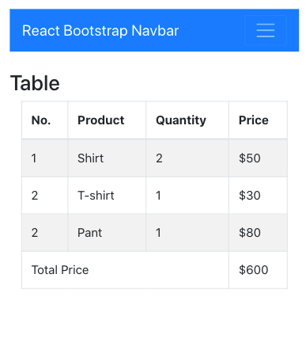

Slide 6
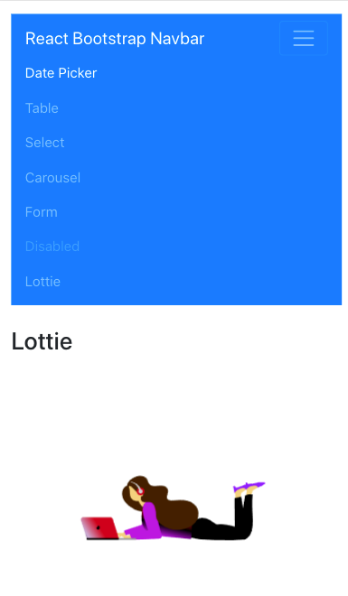
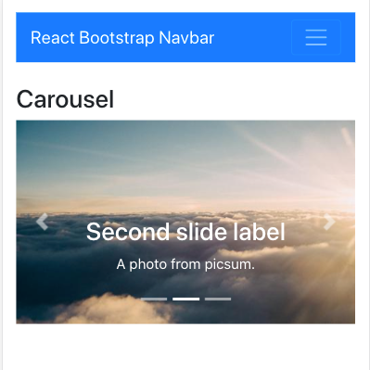

Slide 7
PART 1 BOOTSTRAP COMPONENTS
https://react-bootstrap.github.io/components/alerts/

Slide 8
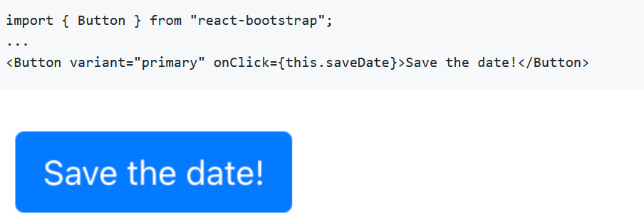
Button
https://react-bootstrap.github.io/components/alerts/

Slide 9
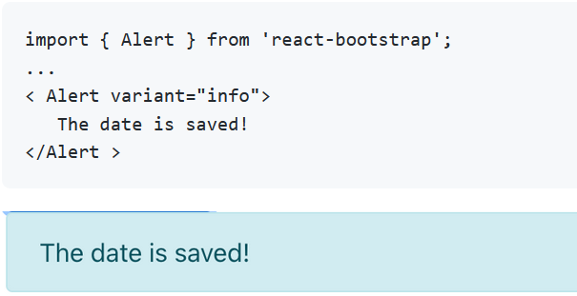
Alert

Slide 10
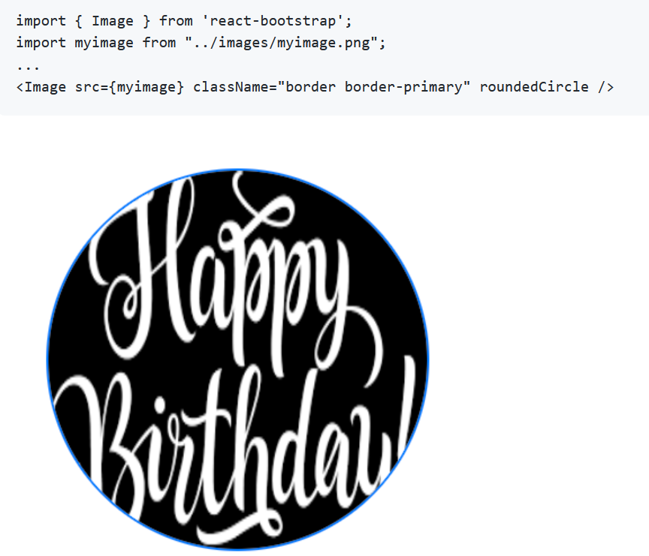
Image

Slide 11
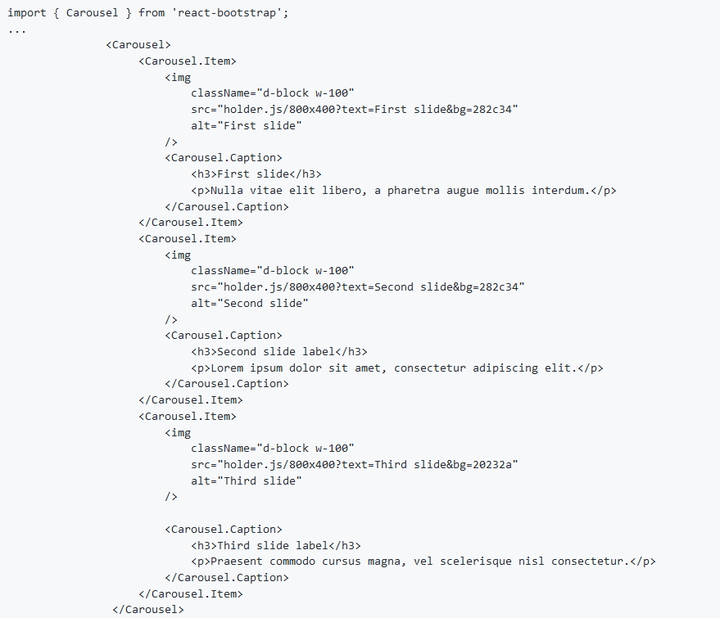
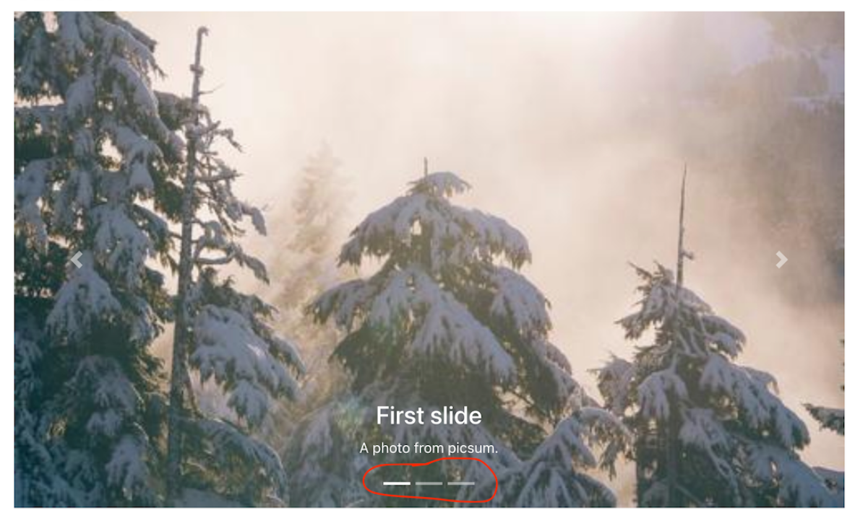
Carousel
Tutorial: https://www.freakyjolly.com/react-bootstrap-carousel-example-tutorial/

Slide 12
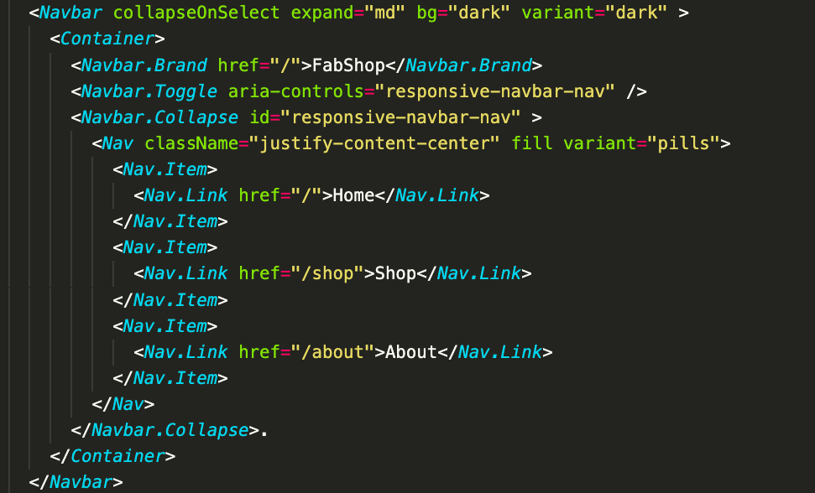
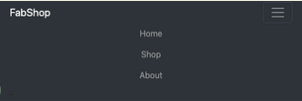
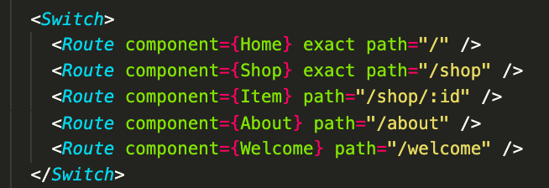

Navbar with Router
AppRouter.js

Slide 13
PART 1 LOTTIES

Slide 14
Lotties
A Lottie is a JSON-based animation file format enabled for any platform - Android, iOS, web etc. It is a small file that works on different devices and scale easily
Lottie was developed by Airbnb. The top 500 apps on the App Store use Lottie to engage users and enhance conversations. It is 600% smaller than gif and 10x faster to ship

Slide 15
How to use Lottie?
Install the library using npm install --save react-lottie. A dependency concerning react-lottie should be present in package.json.
Select an animation from LottieFiles. For example, musicalgal.
In your React project, create a directory to store your Lottie animations (let's say animations) and create a JSON file with your Lottie (for example musicalgal.json).
To use your lottie, you need to import the react-lottie player component and the lottie JSON file.
import Lottie from "react-lottie";
import musicgalimg from '../animations/musicgal';

Slide 16
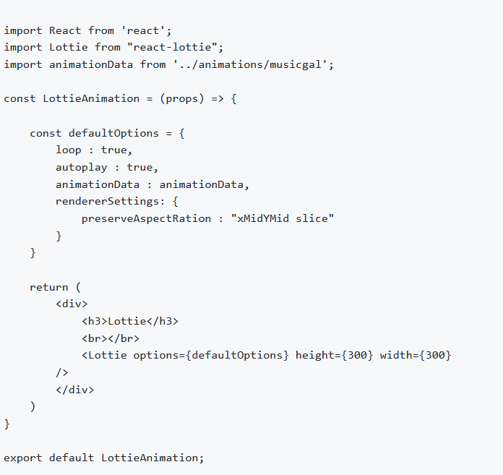
Display a Lottie
Different options to display a Lottie:
animationData: Object with the exported animation data
loop: Repetition of the animation: true / false / number
autoplay: Auto-plays when the player is ready (true / false)
name: Animation name for future reference
renderer: 'svg' / 'canvas' / 'html' to set the renderer
container: Dom element on which to render the animation

Slide 18
PART 3 YOUR TURN IN
YOURSHARE

